Slide 1
BATTLE OF THE NEIGHBORHOODS- MYTH OR REALITY?: Schools play a role in real estate
Case Study of Charlotte, North Carolina
By-
Raveena Sarwal
December 2019

Slide 2
Project background
CAPSTONE PROJECT- BATTLE OF NEIGHBORHOODS
USE LOCATION DATA TO EXPLORE A GEOGRAPHICAL LOCATION
USE FOURSQUARE LOCATION DATA & ANALYSIS

Slide 3
METHODOLOGY
DATA COLLECTION
DATA WRANGLING
DATA VISUALIZATION
STATISTICAL ANALYSIS
FOURSQUARE VENUE EXPLORATION
K-CLUSTERING
Data Collected by Secondary Sources
Data Cleaning
Merging Data
Exploratory Data Analysis
Correlation
Maps

Slide 4
DATA REQUIREMENT (SECONDARY DATA)
Identified data for the study:
Affluent Neighborhoods in Charlotte Area,
Real Estate Values of Charlotte Area,
List of Schools,
School Ranking,
Accessibility of neighborhoods to nearby venues,
Crime Rate, if possible

Slide 5
DATA SOURCES (SECONDARY DATA- WEBSITES)
List of Schools and School Performance Grades: http://www2.cms.k12.nc.us/cmsdepartments/accountability/Pages/PerformanceDashboardNew.aspx;
Zip code names: https://www.zipdatamaps.com/mecklenburg-nc-county-zipcodes;
School codes: https://nces.ed.gov/ccd/schoolsearch/school_list.asp?Search=1&DistrictID=3702970;
School and Neighborhood Rankings: https://www.niche.com/k12/search/best-public-elementary-schools/d/charlotte-mecklenburg-schools-nc/;
Real estate values: https://www.zillow.com/charlotte-nc-28205/home-values/;
Maps: https://opendata.arcgis.com/datasets/87376bdb0cb3490cbda39935626f6604_0.geojson?where=STATE%20like%20'%25NC%25'%20AND%20CITY%20like%20'%25Huntersville%25';
US cities data: https://simplemaps.com/data/us-cities.

Slide 6
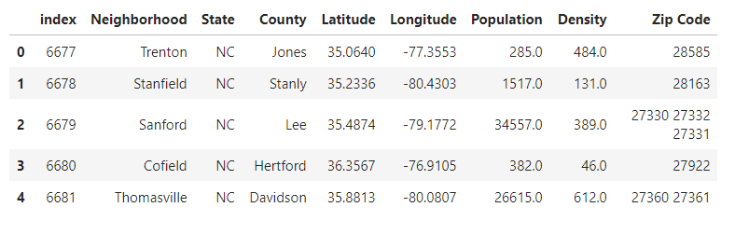
DATA AT A GLANCE
CLEANED DATA WITH REQUIRED INFORMATION ON:
NEIGHBORHOOD,
COUNTY,
POPULATION,
DENSITY,
ZIP CODE.

Slide 7
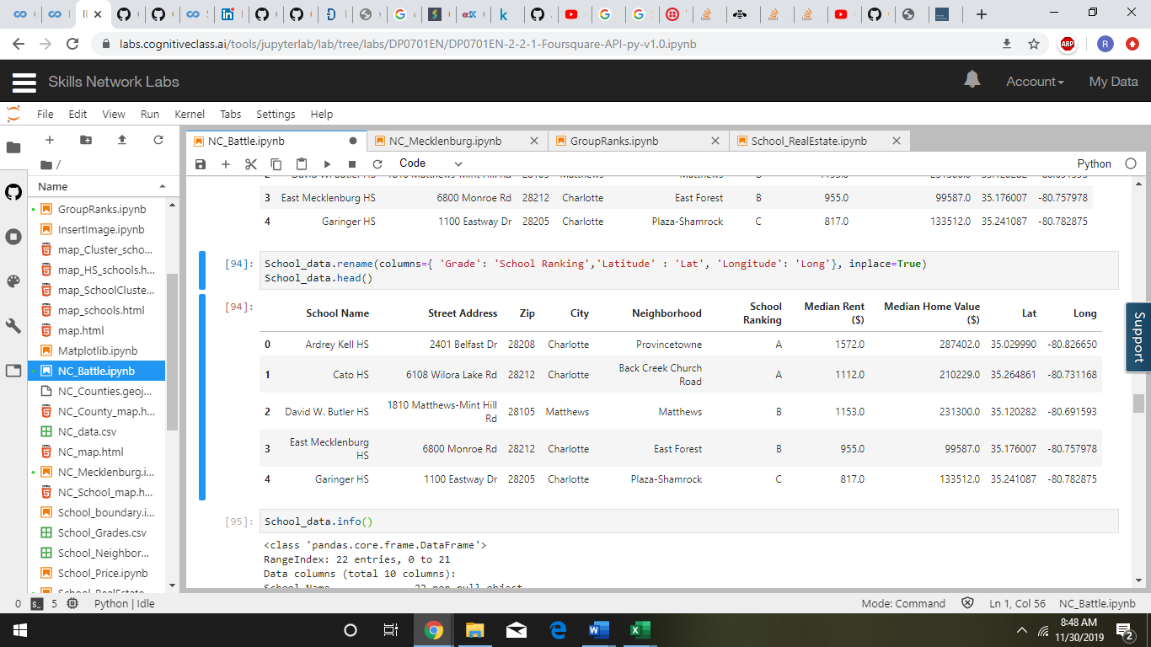
DATA AT A GLANCE
CHARLOTTE, NC SCHOOL INFORMATION:
SCHOOL NAME
SCHOOL ADDRESS
CITY
COUNTY
SCHOOL RANKING

Slide 8
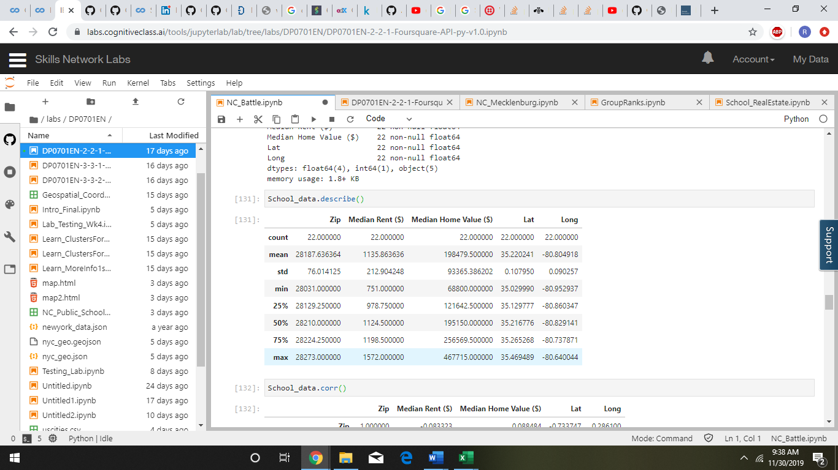
DATA EXPLORATORY ANALYSIS
STATISTICAL ANALYSIS:
CORRELATION
MEDIAN
MEAN
STANDARD DEVIATION
MIN
MAX
MIN. MEDIAN RENT ($) IS 751 AND MAX. MEDIAN RENT IS 1572
MIN. MEDIAN HOME VALUE ($) IS 68800 &
MAX. MEDIAN HOME VALUE ($) IS 467715
GIVES AN IDEA OF THE RENT AND HOME VALUES

Slide 9
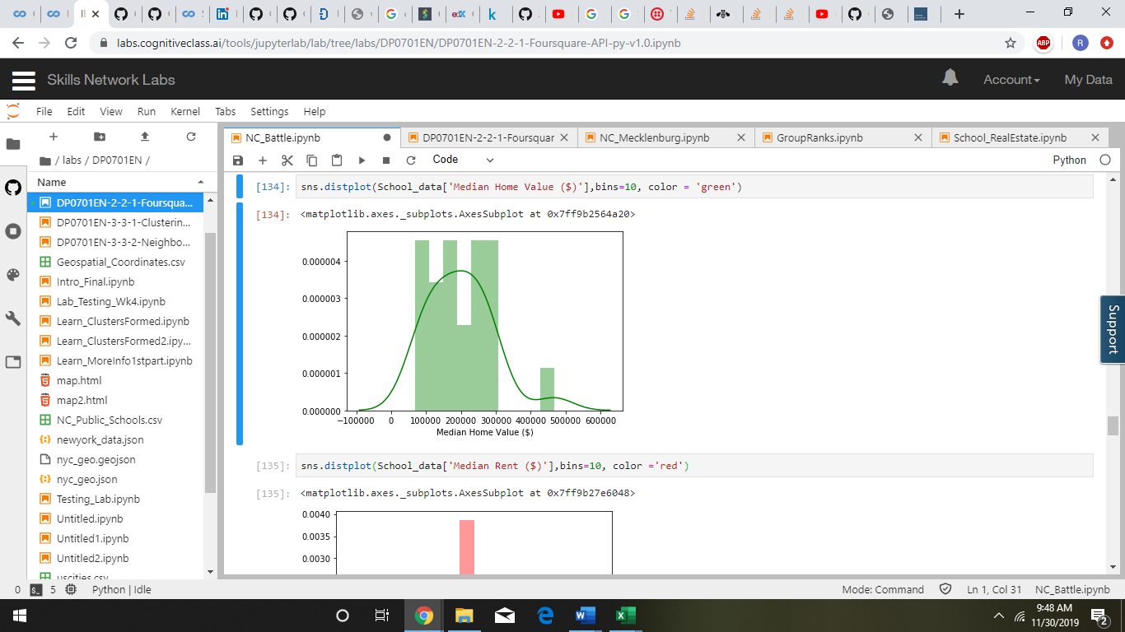
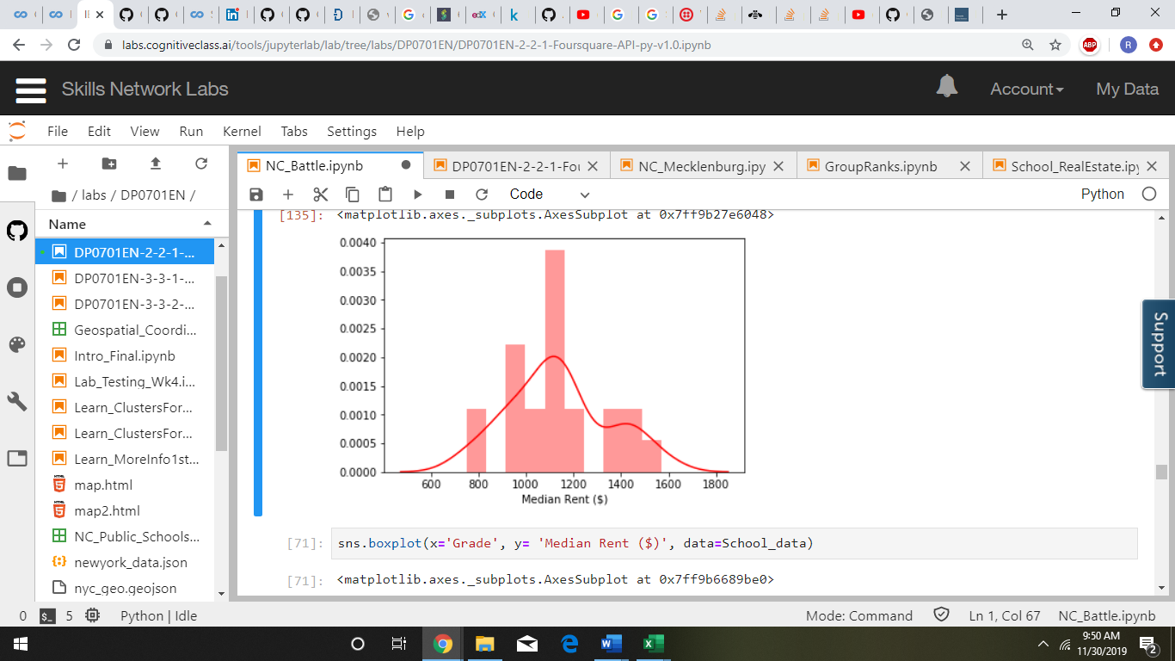
DATA EXPLORATORY ANALYSIS
Range of Median Home Value ($)
Range of Median Rent ($)
GIVES AN IDEA OF THE RENT AND HOME VALUES

Slide 10
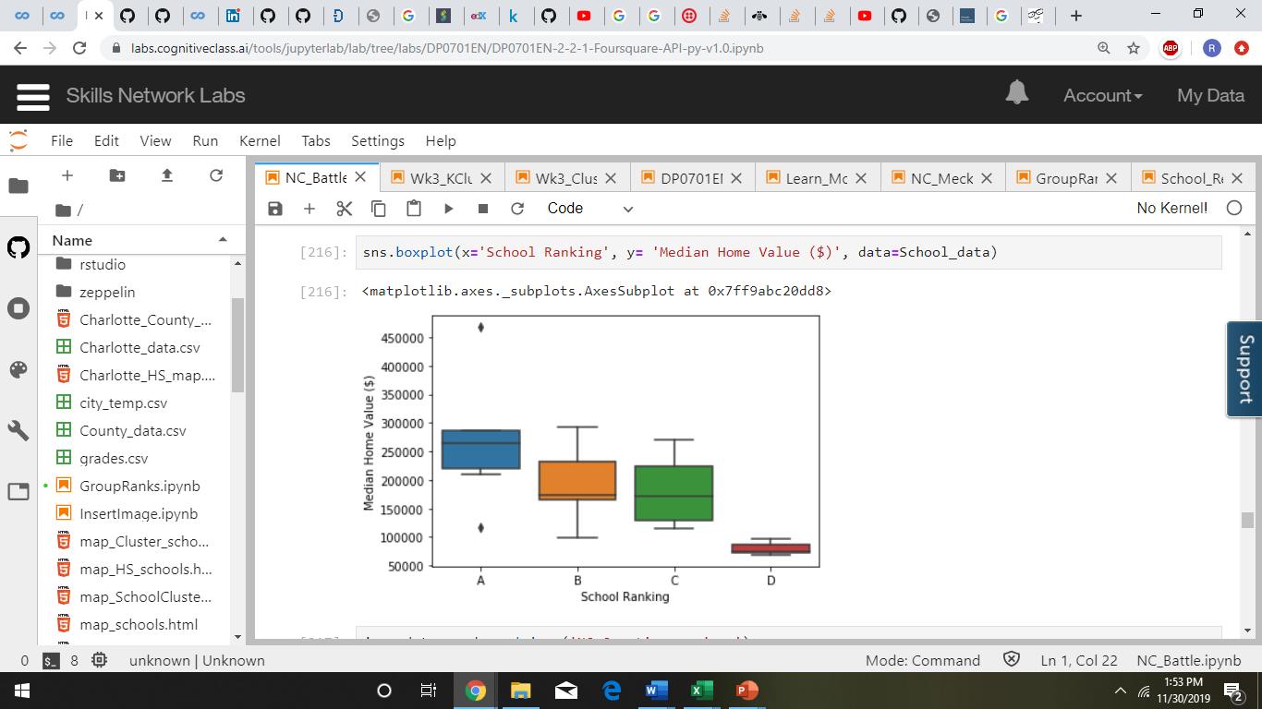
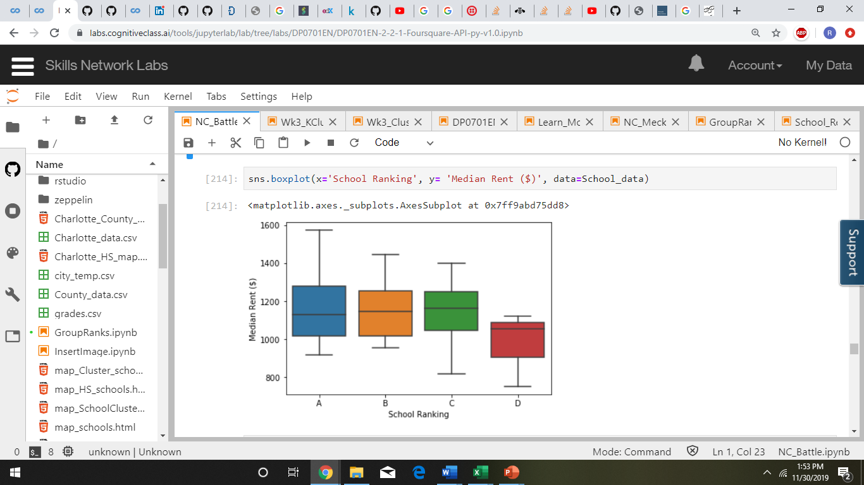
DATA ANALYSIS STATISTICAL ANALYSIS
Grouped Median Home Value ($) and Median Rent ($) based on School Ranking
High Home Values and Rent in the neighborhoods with
good school ranking
People willing to pay more for neighborhoods with
good school ranking.
SCHOOL RANKING SHOWS AN IMPACT ON REAL ESTATE

Slide 11
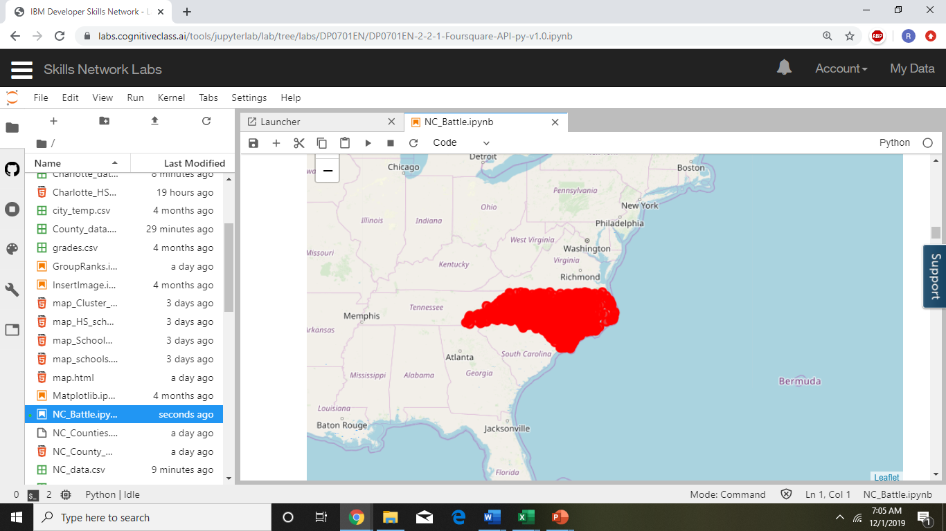
MAP: North Carolina
USING GEOLOCATOR
OBTAINED LATITUDES & LONGITUDES

Slide 12
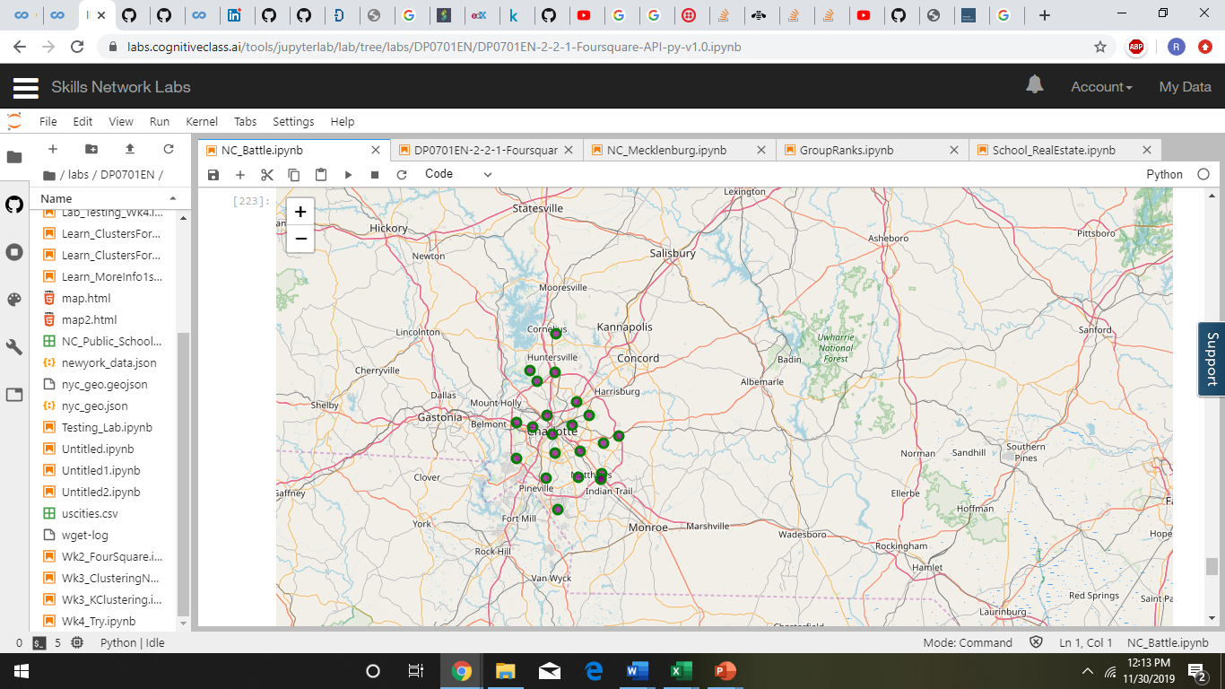
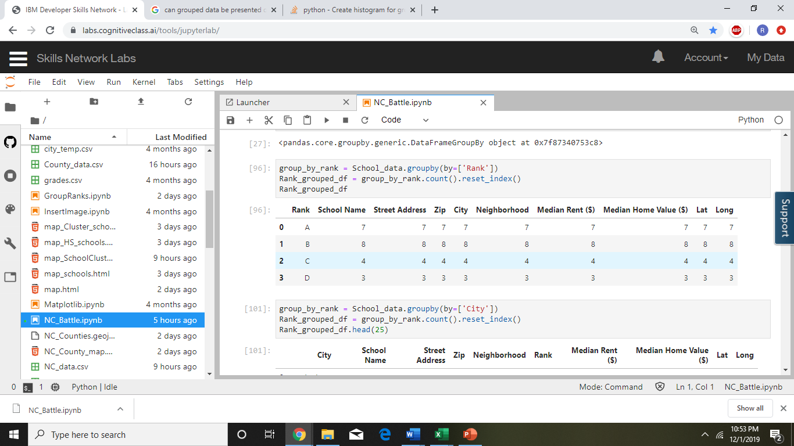
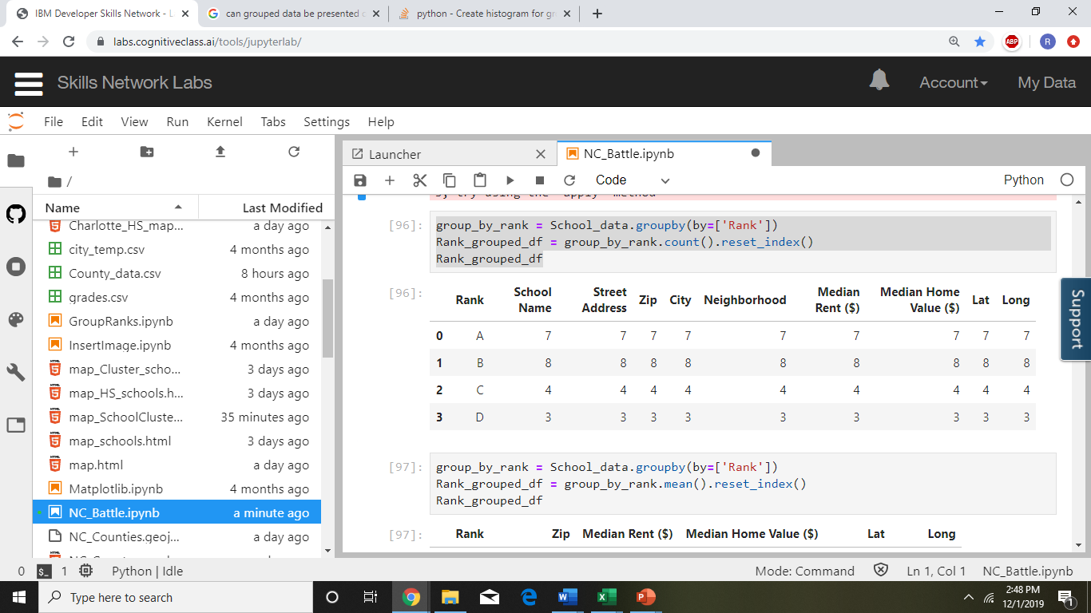
Map: charlotte area WITH Charlotte High SchoolS

Slide 13
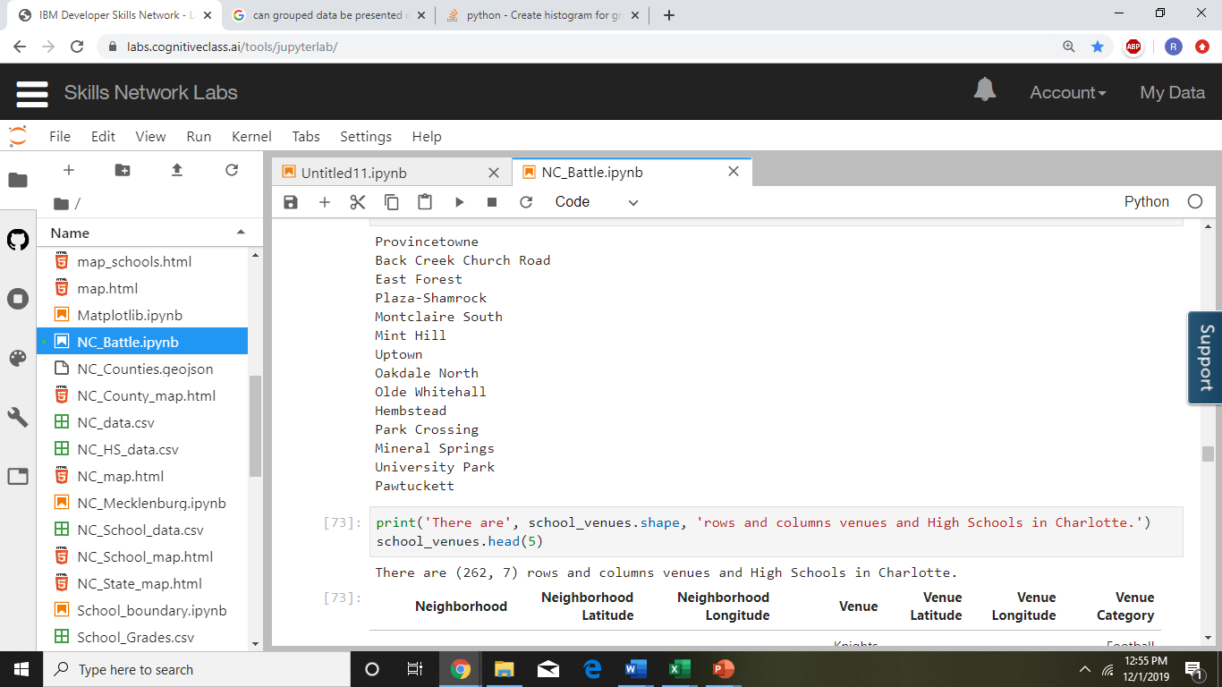
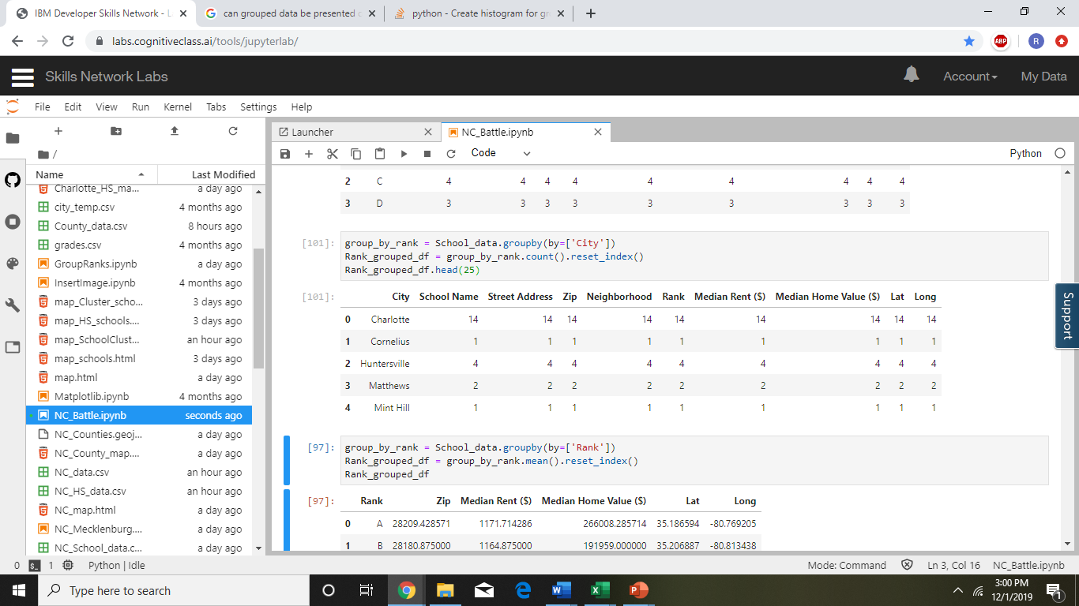
FOURSQUARE VENUE ANALYSIS
Concentration of High Schools in Charlotte Neighborhoods
These neighborhoods are in these cities with schools concentrated more in Charlotte City
Charlotte City has the maximum number of High Schools

Slide 14
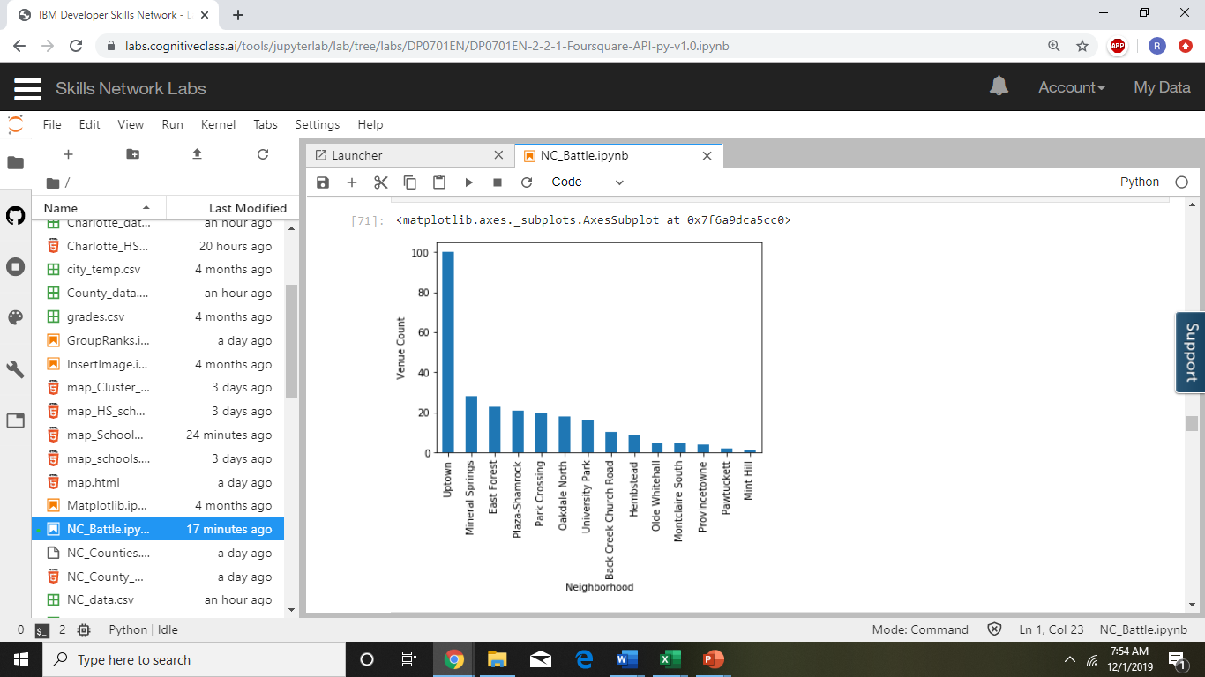
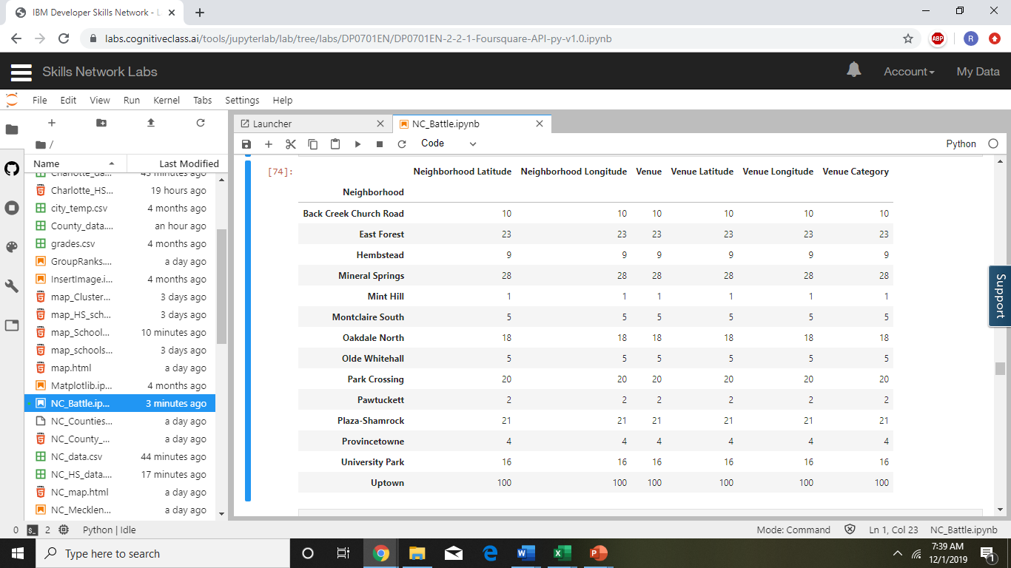
FOURSQUARE VENUE ANALYSIS
Uptown is the Central Business District (CBD) of Charlotte
Number of Venues in Each Neighborhood
Mint Hill is a small town in the suburbs of Charlotte

Slide 15
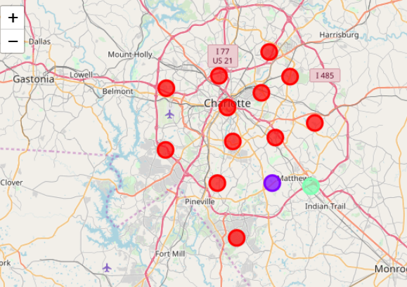
K-CLUSTERING
K= 3
DATA CALIBERATION IN PYTHON
CLUSTER 1 shown in Red
CLUSTER 2 shown in Purple
CLUSTER 3 shown in Green

Slide 16
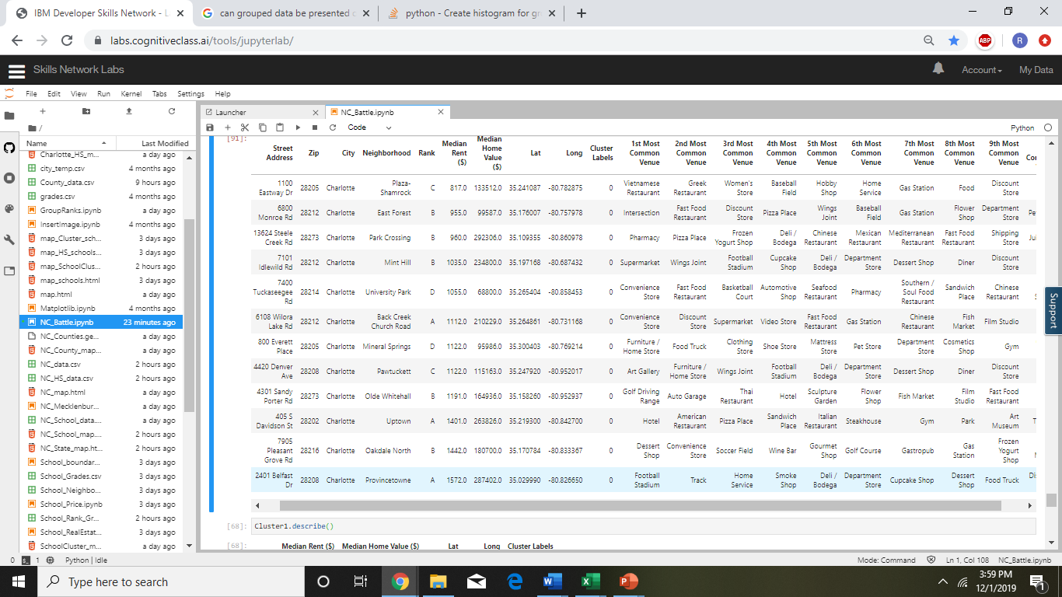
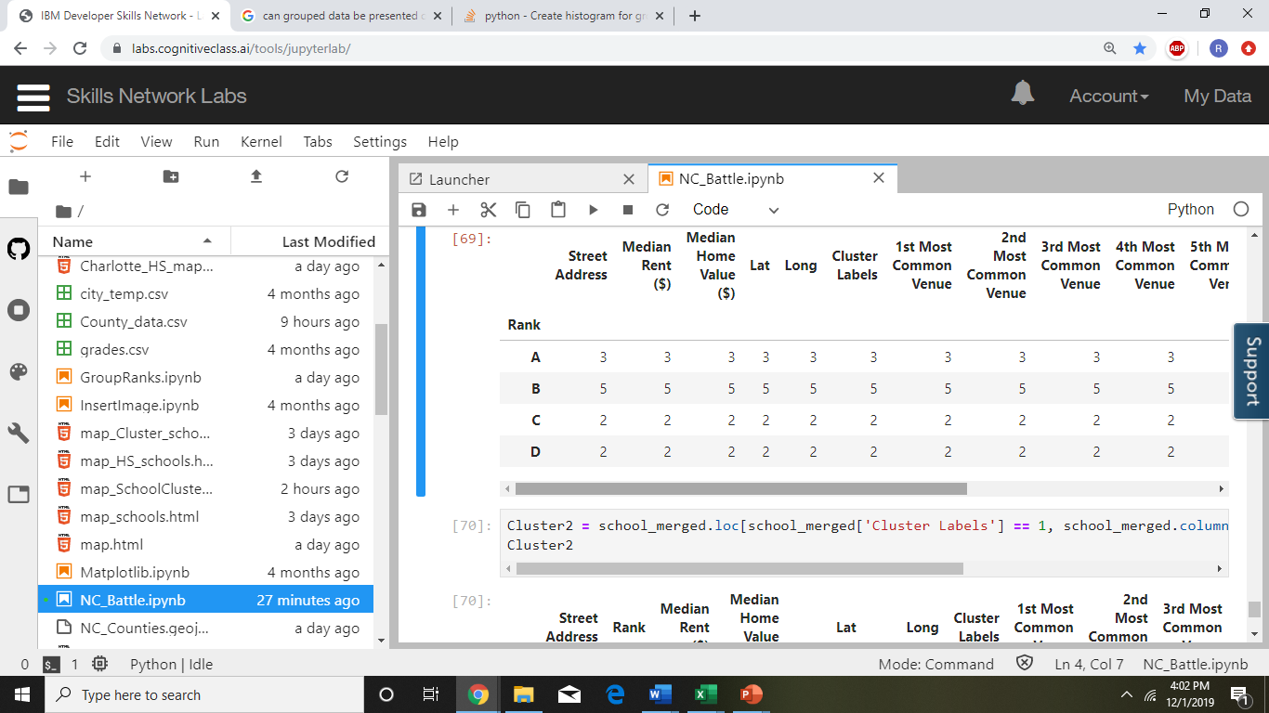
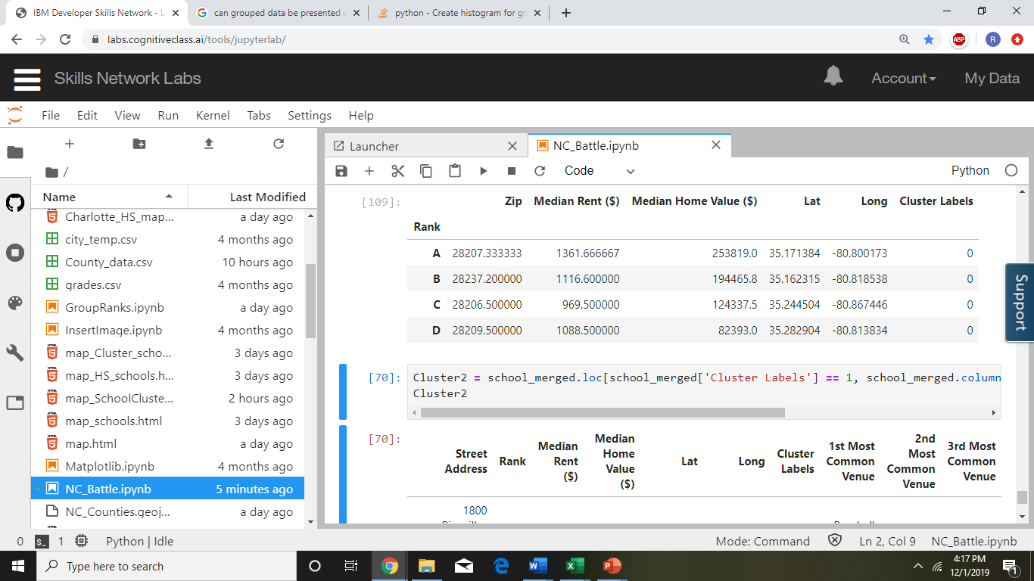

CLUSTER 1 DETAILS
Home values for Rank A schools is the maximum and the least are for schools with Rank D

Slide 17
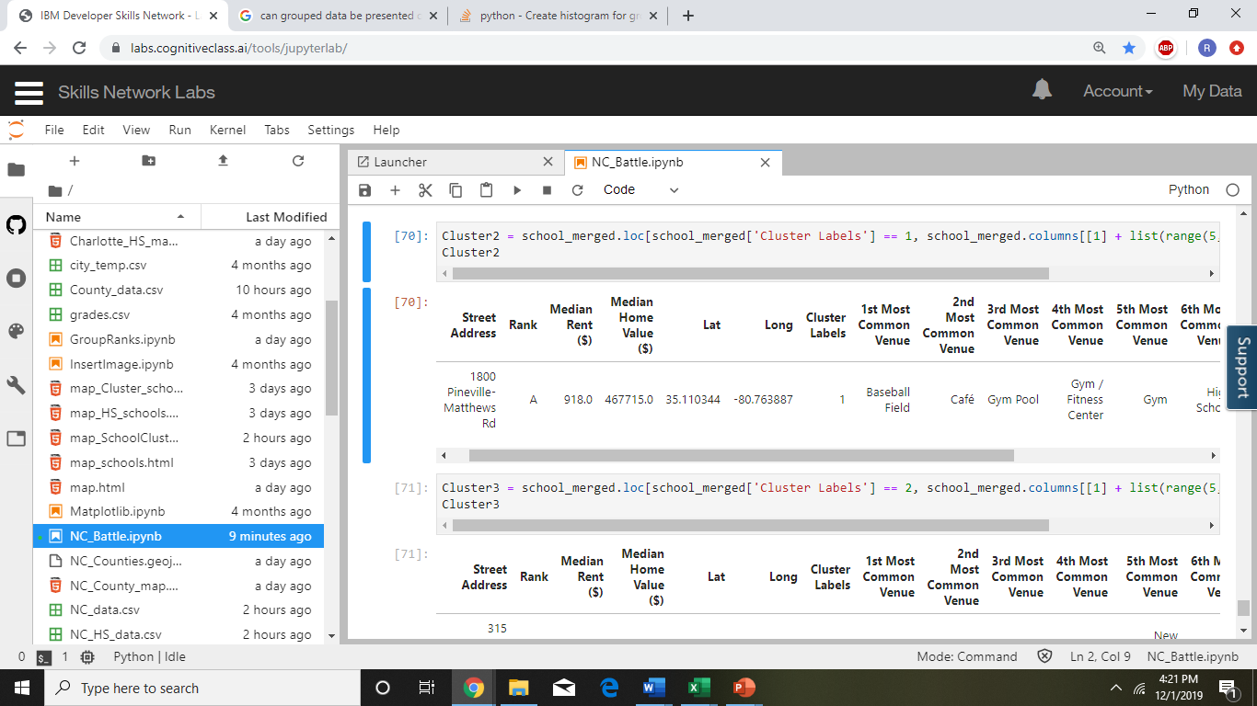
CLUSTER 2 DETAILS
Providence High School is 10 on 10 school and have received Red Ribbon awards from the President.
Extra Curricular activities around this school also reflect High Median Value ($)

Slide 18
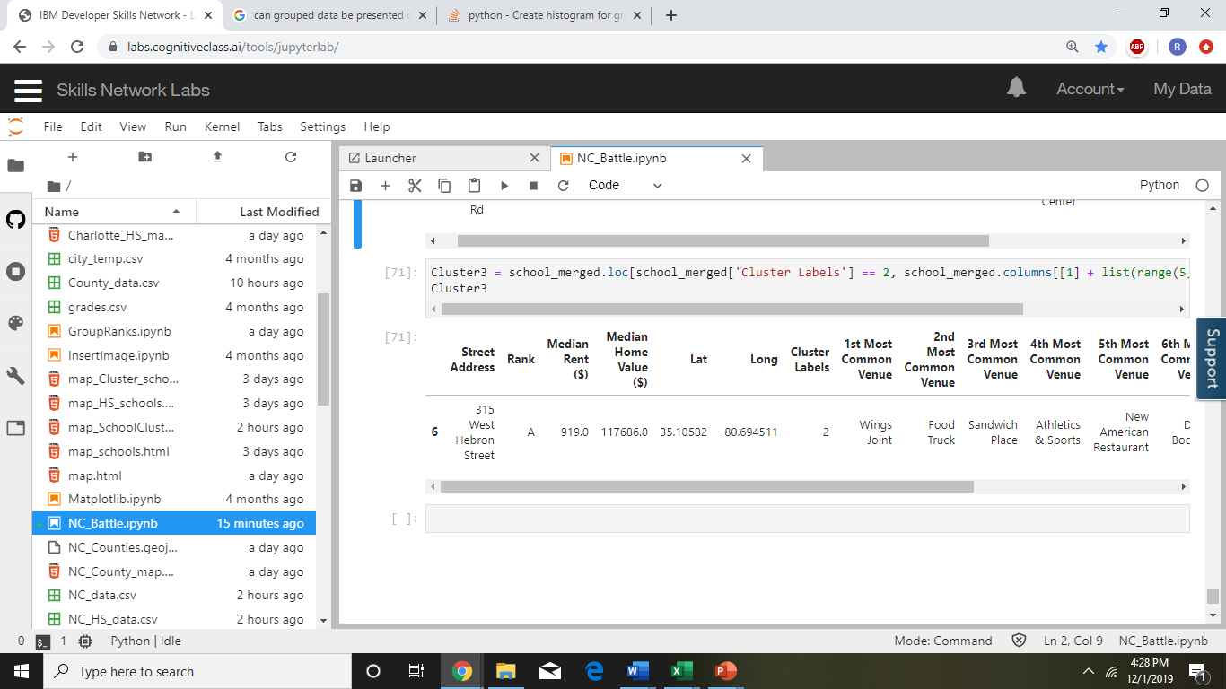
CLUSTER 3 DETAILS
Harper Middle College High is a school offering College credits with aggregated Rank A

Slide 19
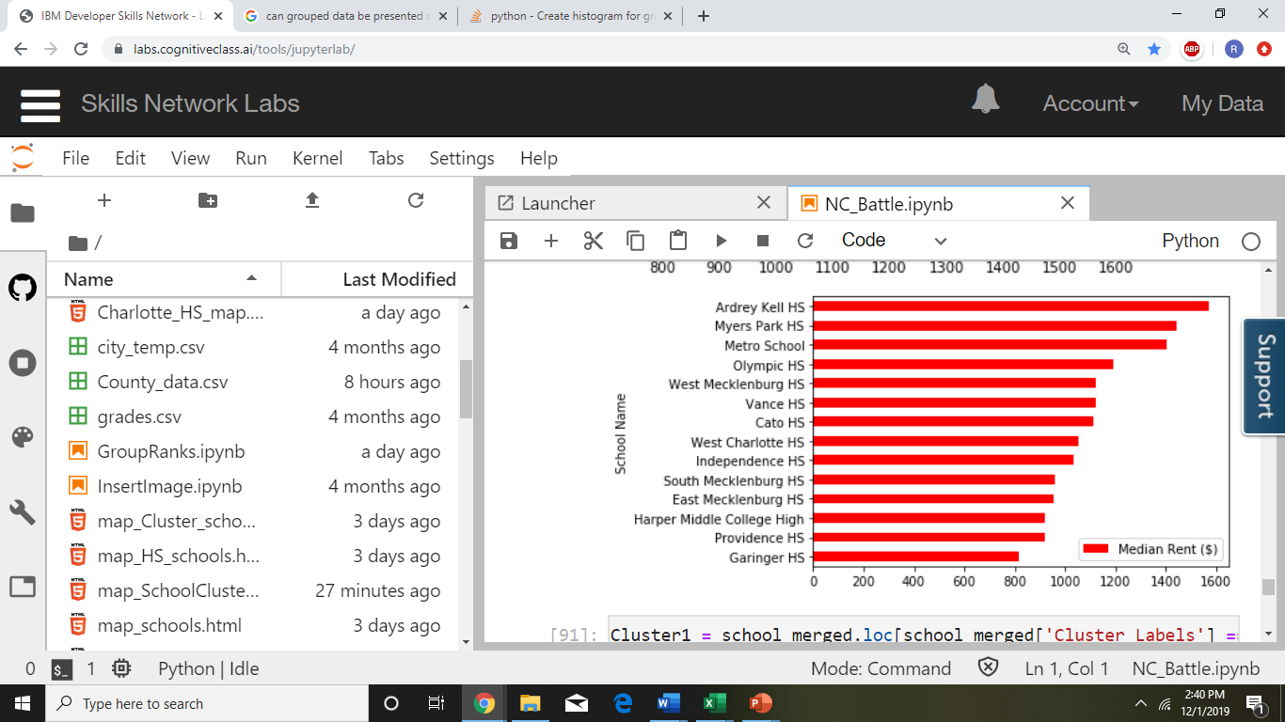
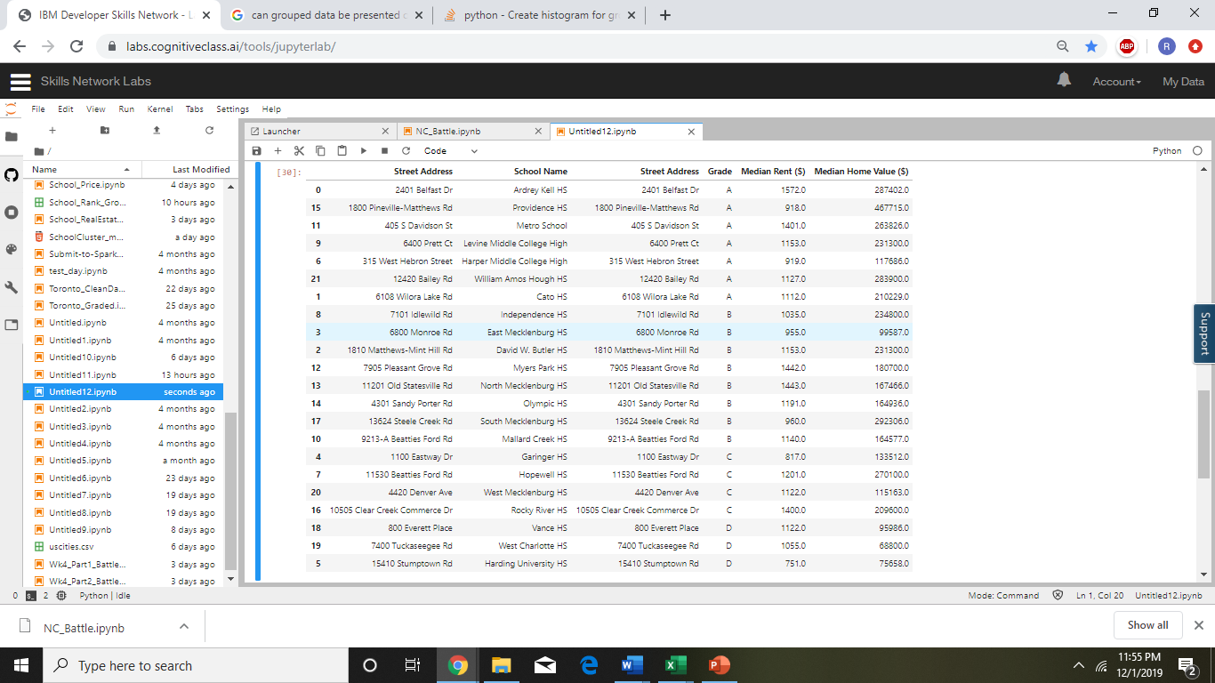
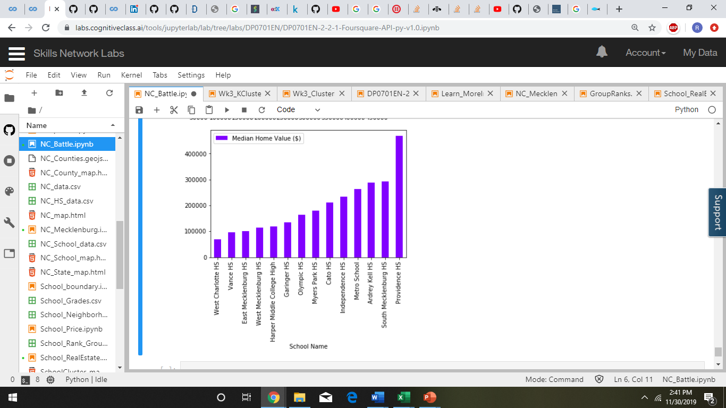
CONCLUSION
REAL ESTATE IS DIRECTLY PROPERTIONAL TO SCHOOL RANKING

Slide 20

THANK YOU

